Slide 1

Employee Segmentation on Absenteeism
MINI PROJECT 1

Slide 2
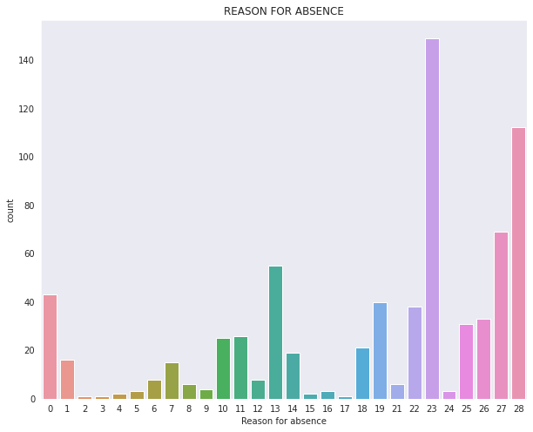
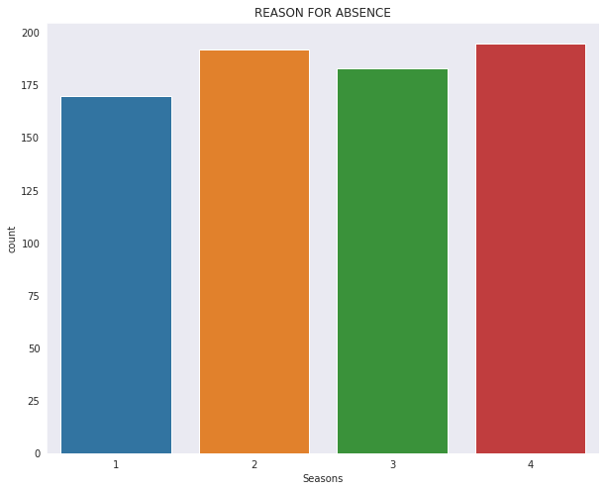
EXPLORATORY Data ANALYSIS
Reason for absence can be , Timing of absence (Date & Season based), Duration of
absence, Employee personal details (mostly health), Workload & targets to meet at office etc.
Mostly 145 people are absent and given 23rd reason
People mostly Absent in 4th season

Slide 3
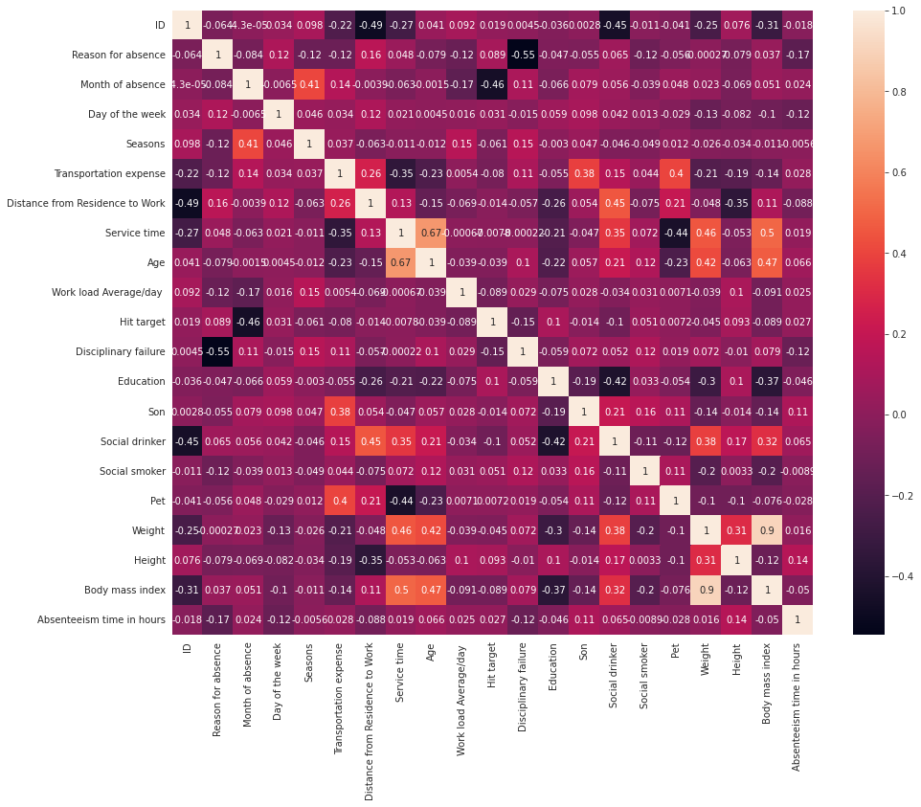
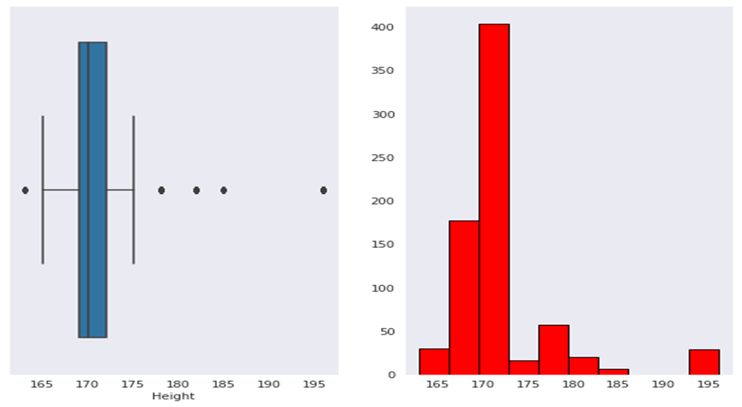
ABOVE HEATMAP SHOWING MULTICOLLINEARITY BETWEEN INDEPENDENT COLUMNS
So I will consider using PCA
Correlation between Body mass Index an Weight ----> 0.9
Correlation between Age and Service Time ---->0.67
Dataset Contain Outliers

Slide 4
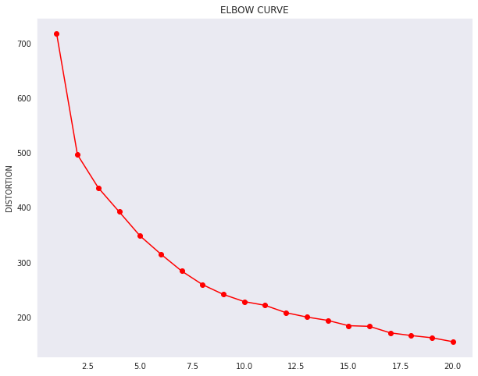
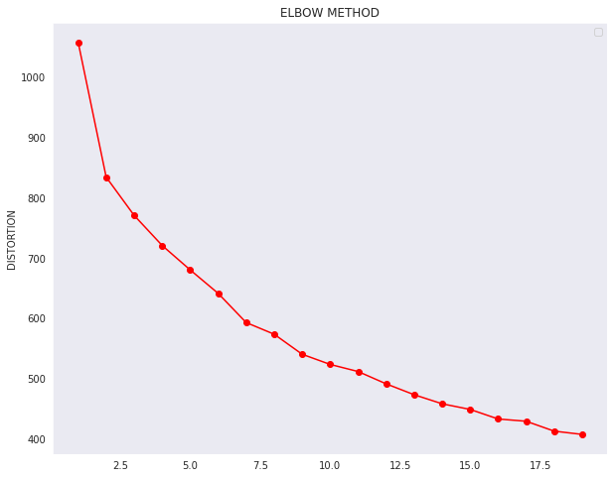
SILHOUTTE AND ELBOW METHOD
We are using Silhoutte and Elbow method to determine Number of Cluster
Elbow curve using PCA Elbow curve without using PCA
Both curves showing K=2
From above curve we Can Inference to plot Two Clusters

Slide 5
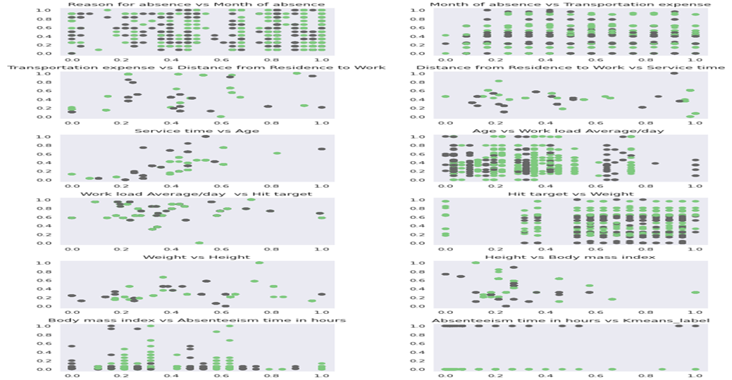
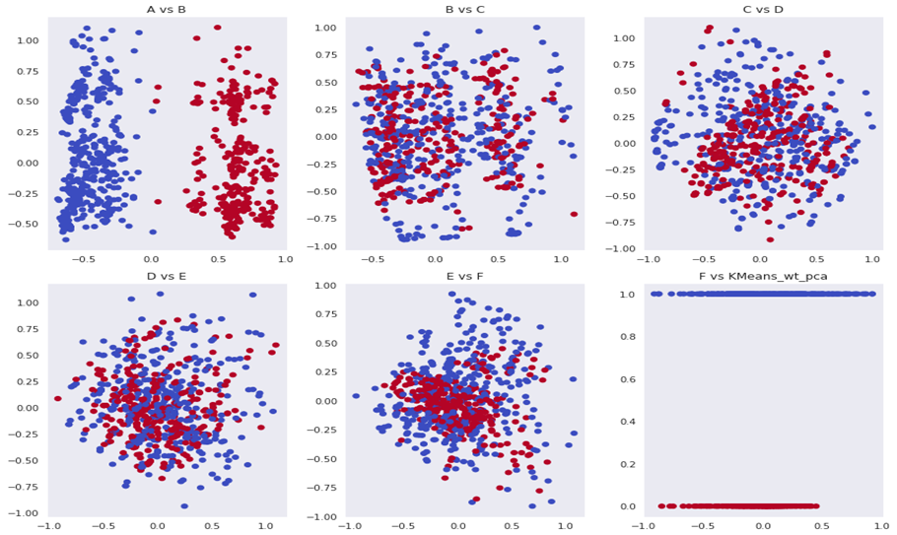
KMEANS ELBOW SHOWING NUMBER OF CLUSTER IS : 2
SILLHOUTTE WITHOUT PCA SILLHOUTTE WITH PCA
0.212588 0.4141
We can observe that Silloutte score increases after doing PCA
Cluster After Doing PCA is More Define

Slide 6
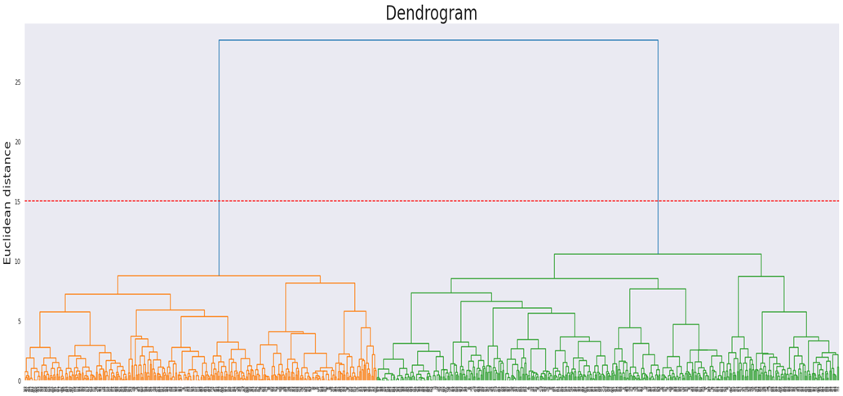
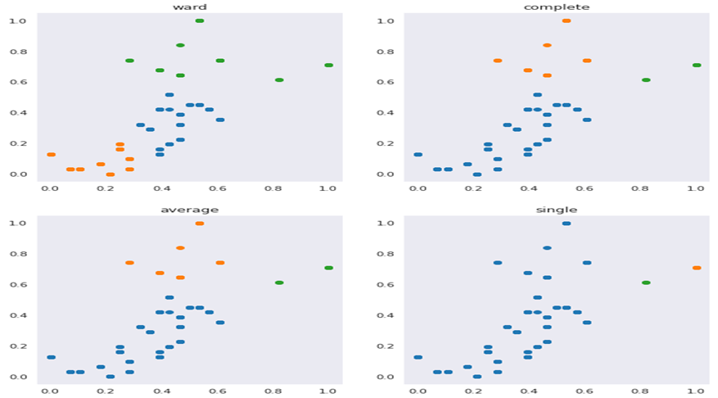
Agglomerative Hierarchical clustering algorithm
From Agglomerative Hierarchical clustering we can observe number of cluster from Dendogram
The best linkage which is giving Better result is ward

Slide 7
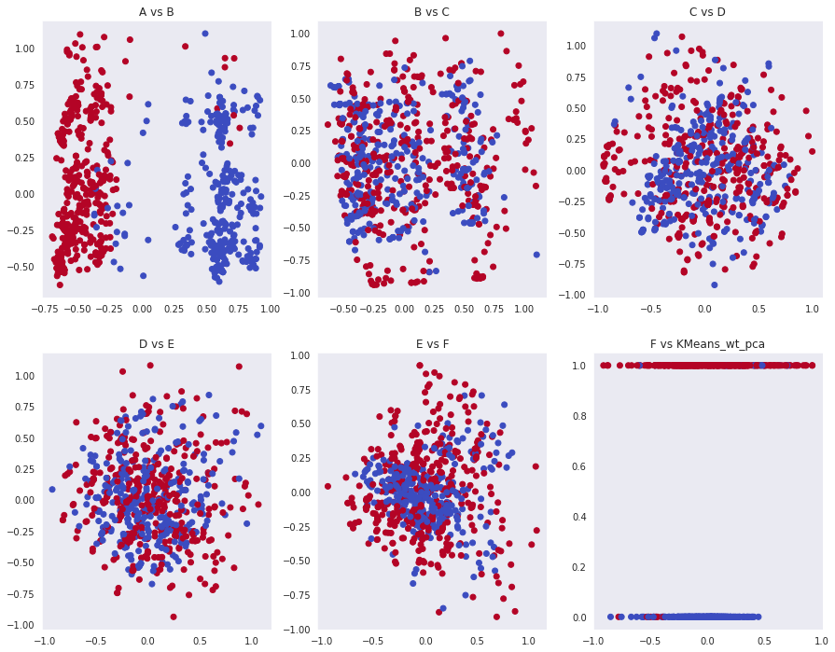
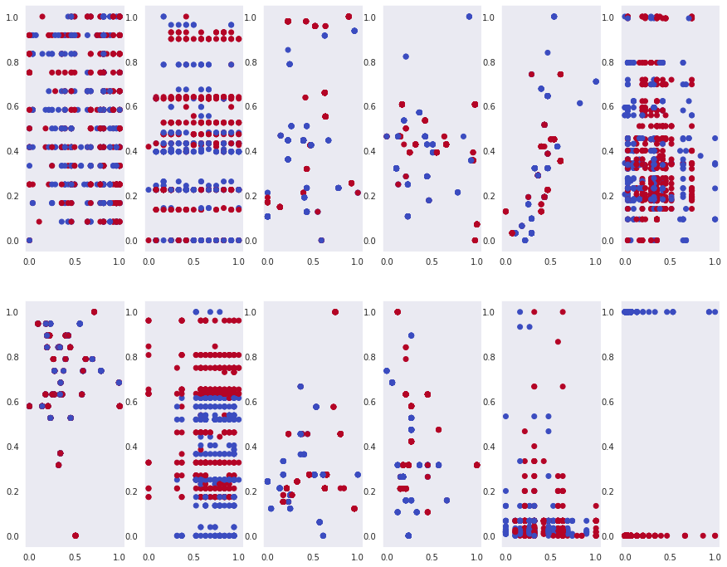
Clustering With PCA Clustering Without PCA
Sillhoutte Score : 0.451477 Sillhoutte Score : 0.354527
We can observe that Sillhoutte score increases after doing PCA

Slide 8
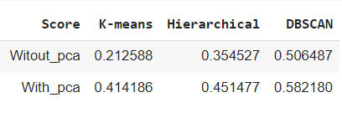
DBSCAN
DBSCAN Sillhoutte Score is much better than other two models but cluster are to much so for Further Analysis
I Have taken Hierarchical clustering
The silhouette ranges from -1 to +1 where a high value indicates that the object is well matched to its own cluster and poorly matched to neighboring cluster
By taking into consideration from Silhouette score we can conclude that DBSCAN in both the condition with and without dimension reduction performing well

Slide 9
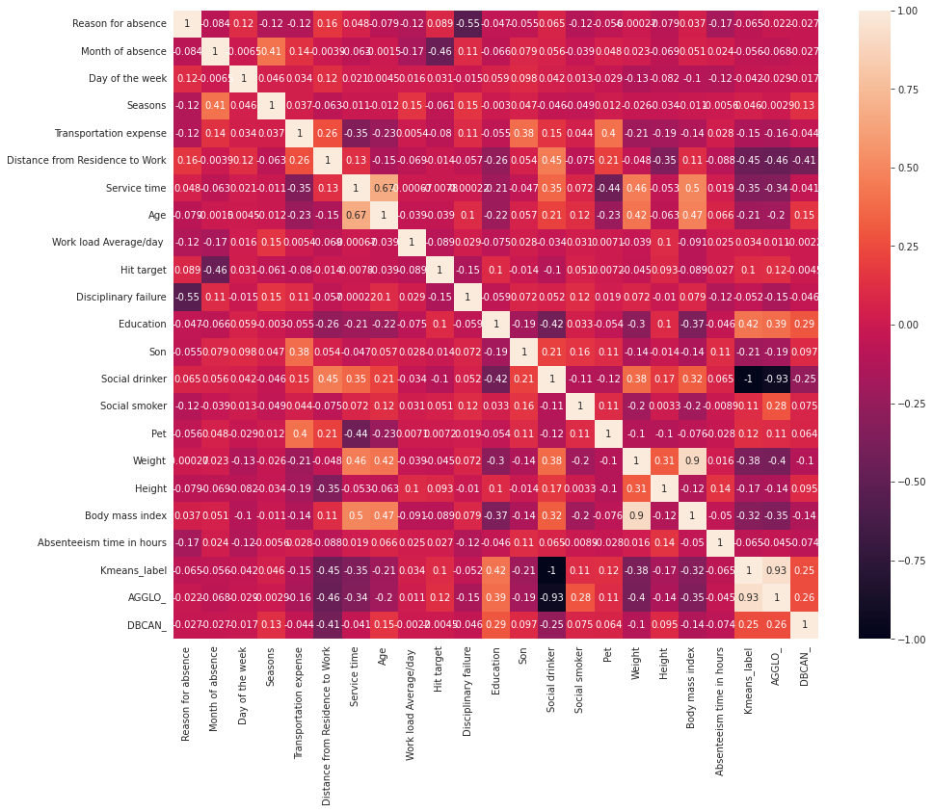
CONCLUSION
Attributes Affecting the most when it comes to
Absentism are as follows as observed
from the heatmap
SOCIAL DRINKER
EDUCATION
DISTANCE FROM RESIDANCE TO WORK

Slide 10
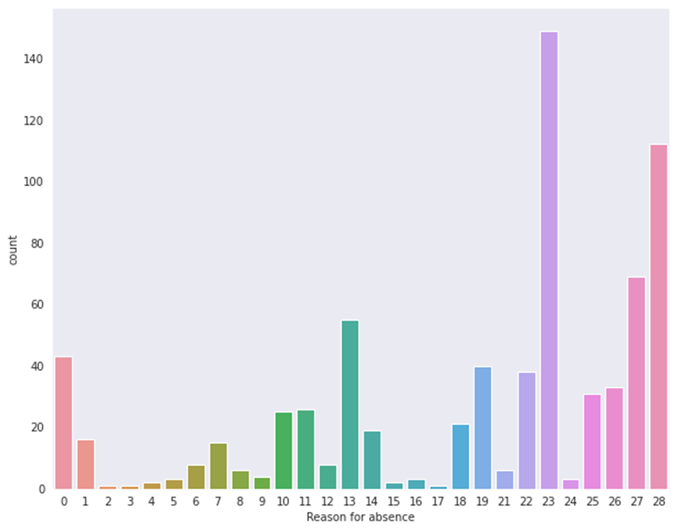
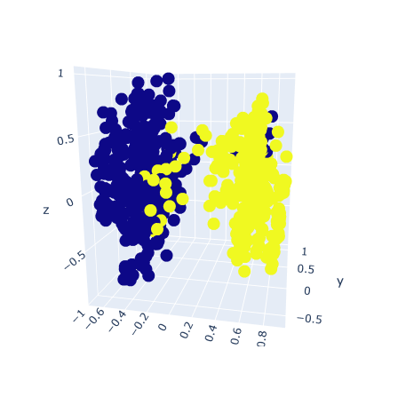
CONCLUSION
The people fall in Cluster first
115 people are absent and given 28th reason

Slide 11
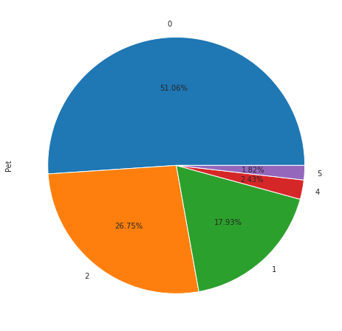
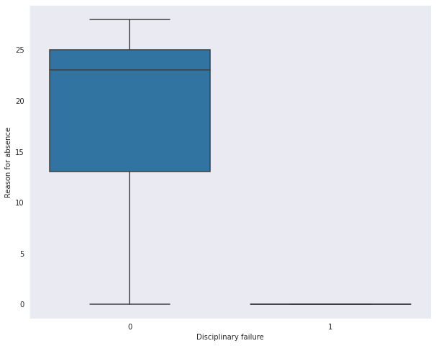
The Pet Falling in Cluster 1
The 0th having higer pets
Displinarary failure of 0th is highest

Slide 12
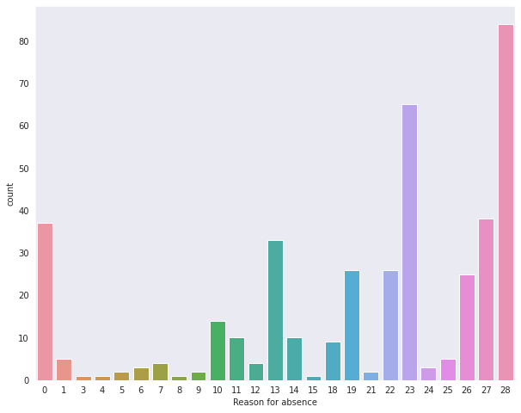
The people fall in Cluster ZERO
90 people are absent and given 28th reason

Slide 13
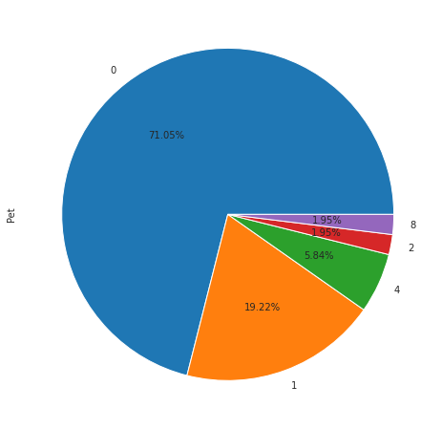
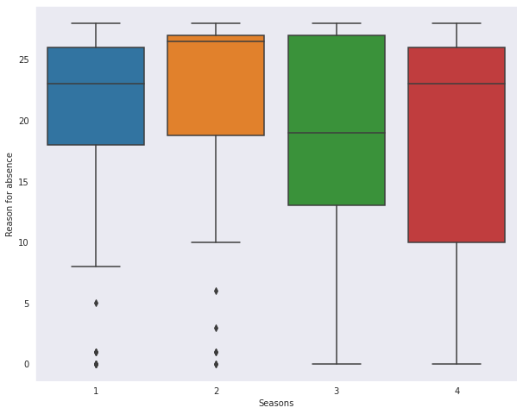
The Pet Falling in Cluster 0
The 0th having higer pets
IN SEASON 4 Maximum People are absentee

